Slide 1
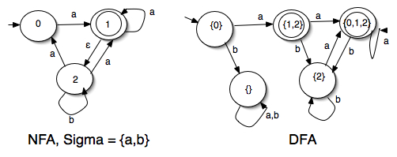
NFA-DFA Equivalence
Course Instructor: Dr. Sohail Iqbal

Slide 2
Recap
is accepted by the NFA:
“accept”
“reject”
because this
computation
accepts
this computation
is ignored

Slide 3
Recap
Language accepted:

Slide 4
NFAs express languages easier than DFAs
Are they Equivalent?
NFA
DFA

Slide 5
Given an NFA, make an equivalent DFA
S={w| w is a string starting with 1}
over alphabet {0, 1}

Slide 6
Equivalence of Machines
Definition:
Machine is equivalent to machine
if

Slide 7
Example of equivalent machines
NFA
DFA

Slide 8
Theorem:
Languages
accepted
by NFAs
Regular
Languages
Languages
accepted
by DFAs
NFAs and DFAs accept the same set of languages

Slide 9
Proof:
we only need to show
Languages
accepted
by NFAs
Regular
Languages
AND
Languages
accepted
by NFAs
Regular
Languages

Slide 10
Proof-Step 1
Languages
accepted
by NFAs
Regular
Languages
Every DFA is trivially an NFA
Any language accepted by a DFA
is also accepted by an NFA

Slide 11
Proof-Step 2
Languages
accepted
by NFAs
Regular
Languages
Any NFA can be converted to an
equivalent DFA
Any language accepted by an NFA
is also accepted by a DFA

Slide 12
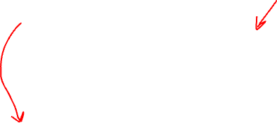
Conversion NFA to DFA
NFA
DFA

Slide 13
NFA
DFA

Slide 14
empty set
NFA
DFA
trap state

Slide 15
NFA
union
DFA

Slide 16
NFA
union
DFA

Slide 17
NFA
DFA
trap state

Slide 18
END OF CONSTRUCTION
NFA
DFA

Slide 19
Next, we shall study the
Summary: NFA and DFA are equivalent
General Conversion Procedure from NFA to a DFA

Slide 20
General Conversion Procedure
Input: an NFA
Output: an equivalent DFA
with

Slide 21
The NFA has states
The DFA has states from the power set

Slide 22
Conversion Procedure Steps
1. Initial state of NFA:
Initial state of DFA:
step
Notes:
Initial State Step

Slide 23
Example
NFA
DFA

Slide 24
step
2. For every DFA’s state
compute in the NFA
add transition to DFA
Union
Notes:
Step for Transitions Function

Slide 25
Example
NFA
DFA

Slide 26
3. Repeat Step 2 for every state in DFA and symbols in alphabet until no more states can be added in the DFA
step

Slide 27
Example
NFA
DFA

Slide 28
step
4. For any DFA state
if some is accepting state in NFA
Then,
is accepting state in DFA

Slide 29

Example
NFA
DFA

Slide 30
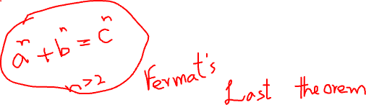
Lemma:
If we convert NFA to DFA
then the two automata are equivalent:
Proof:
We only need to show:
AND

Slide 31
First we show:
We only need to prove:

Slide 32
NFA
Consider
symbols

Slide 33
symbol
denotes a possible sub-path like
symbol

Slide 34
We will show that if
NFA
then
DFA
state
label
state
label

Slide 35

More generally, we will show that if in :
(arbitrary string)
NFA
then
DFA

Slide 36
Proof by induction on
Induction Basis:
NFA
DFA
is true by construction of

Slide 37
Induction hypothesis:
Suppose that the following hold
NFA
DFA

Slide 38
Induction Step:
Then this is true by construction of
NFA
DFA

Slide 39
Therefore if
NFA
then
DFA

Slide 40
We have shown:
With a similar proof
we can show:
Therefore:
END OF LEMMA PROOF

Slide 41
Summary
NFA and DFA are equivalent
Every DFA is trivially an NFA
Every NFA can be converted to DFA
This NFA to DFA Conversion can be done in four steps

Slide 42
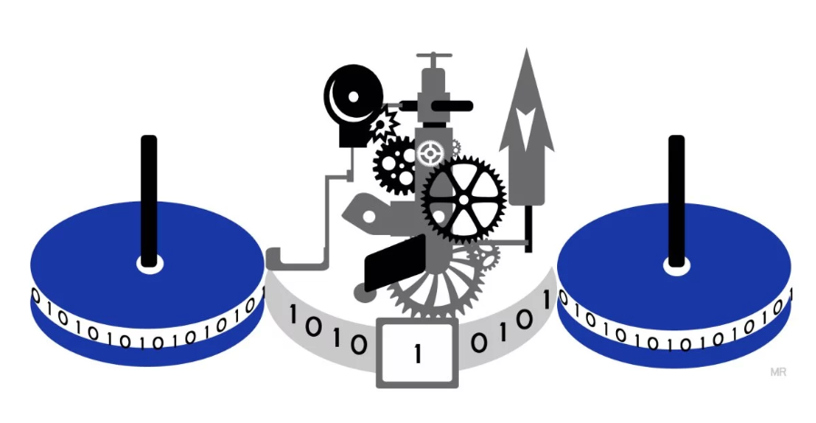
Any Questions?
Have fun with learning!

Slide 43
Be ready for quiz 1

Slide 44
Name………..
Q1. Construct a minimal DFA for the language over the alphabet {0, 1}:
L = { w | w has an odd number of 0s and at least two 1s}
Q2. Design a smallest NFA with λ-transitions that accepts the language over alphabet {a, b}:
L = { w |w contains } “ab” as a substring or ends with “b” }

